Slide 1
Breast Cancer Diagnosis
A Machine Learning Approach To Classification
Hrishikesh Prakash

Slide 2
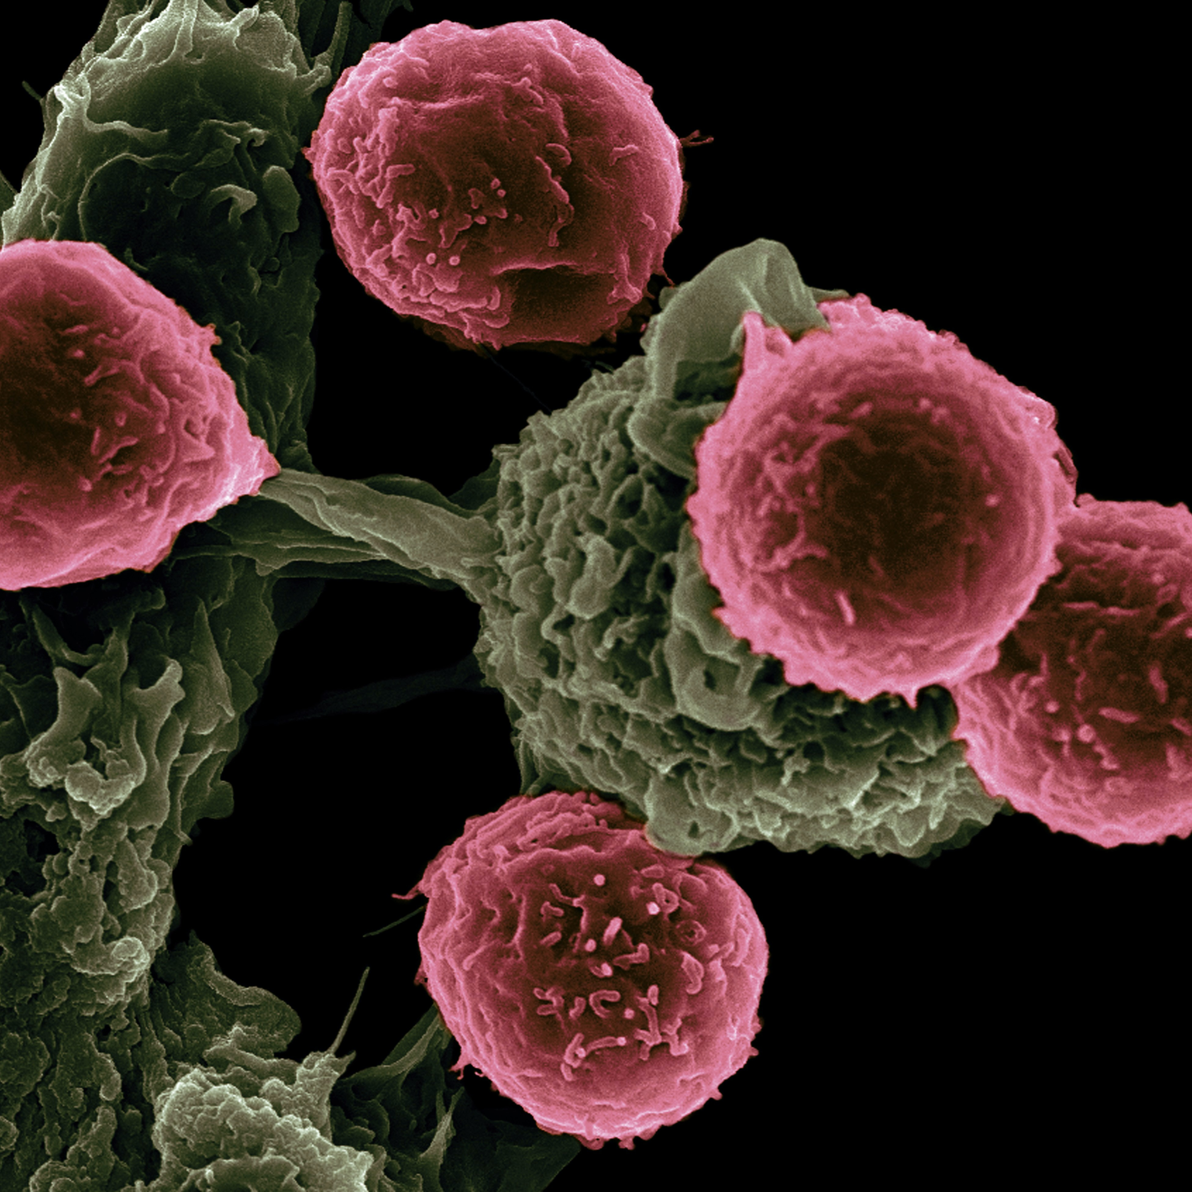
Introduction
Breast Cancer Diagnosis is a crucial task that requires accurate and timely identification of cancerous cells. Our machine learning approach aims to revolutionize the current diagnosis process to improve patient outcomes.

Slide 3
Overview
This project is focused creating a Machine Learning model that can accurately classify Tumor as benign or malignant
Scope for improvements
Types Of Tumor
Benign
Malignant
Model

Slide 4
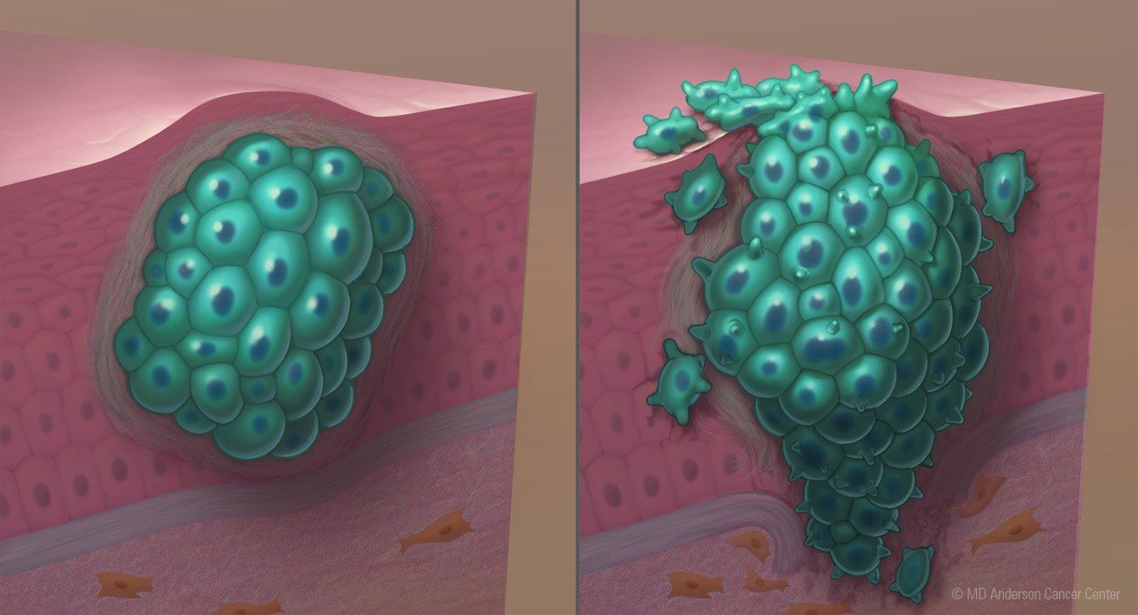
Types of Breast cancer
Benign
Malignant
Non-cancerous growths that form in the breast tissue
Benign breast tumors are relatively common and often do not pose a significant health threat.
Malignant breast cancer refers to cancerous growths that can invade nearby tissues and potentially spread to other parts of the body.
Malignant tumors have the potential to be life-threatening if not diagnosed and treated in a timely manner.

Slide 5
Machine Learning Model

Slide 6
Thank you

